Slide 1
Welcome
CS 472/572
Unsupervised Machine Learning
Autoencoder 1
Week-5 -Class -1
Fall 2025
Instructor: Dr. Khondker Fariha Hossain

Slide 2
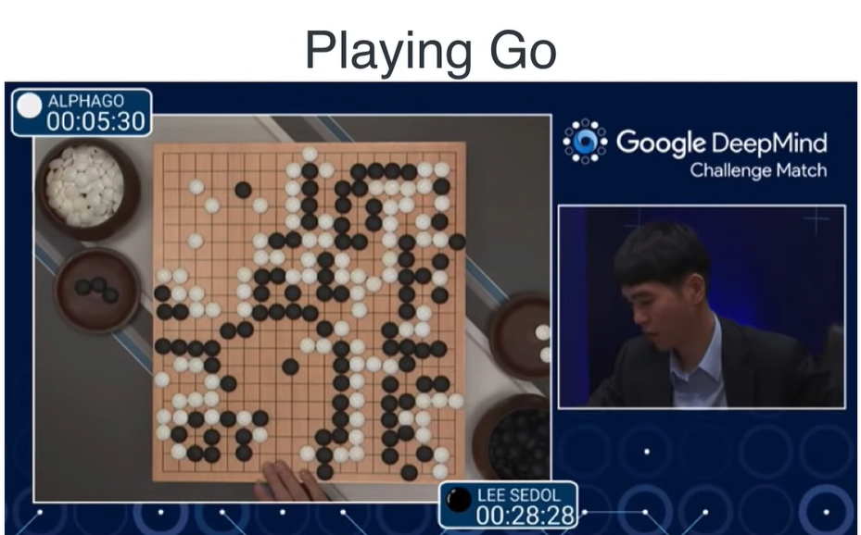
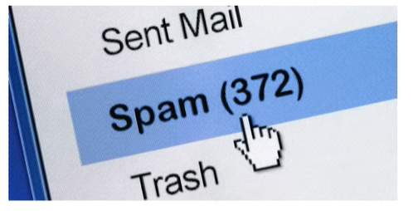
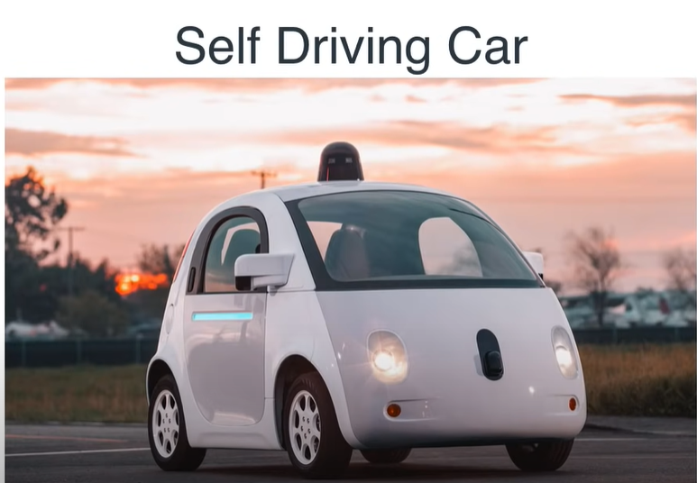
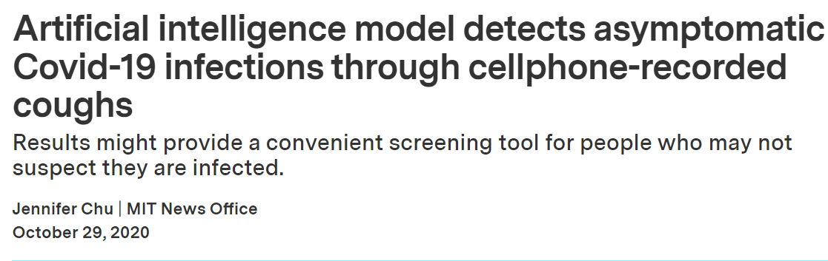
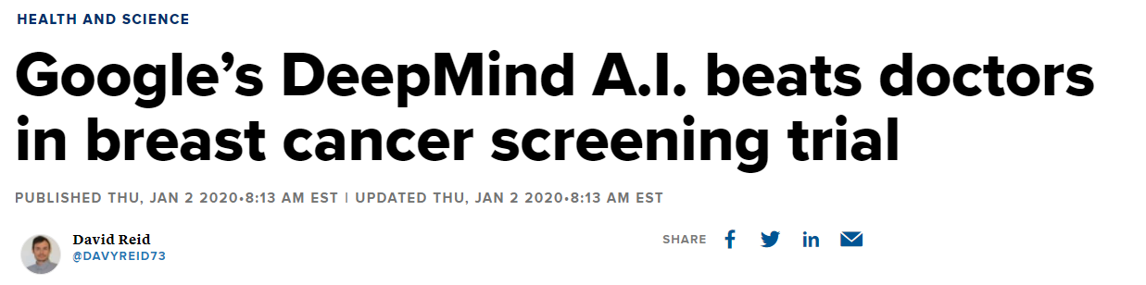
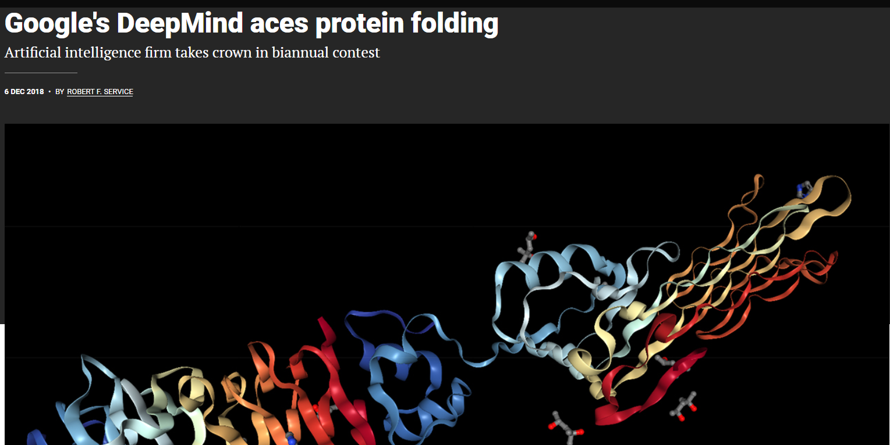

The Rise of Deep Learning

Slide 3
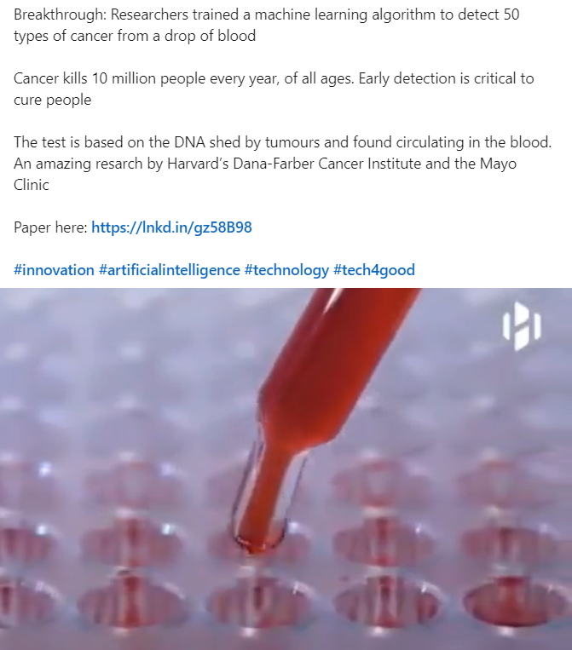
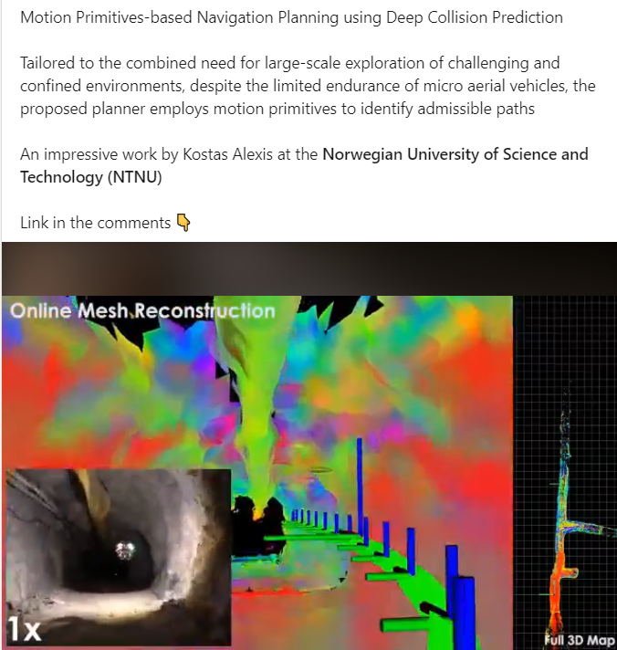
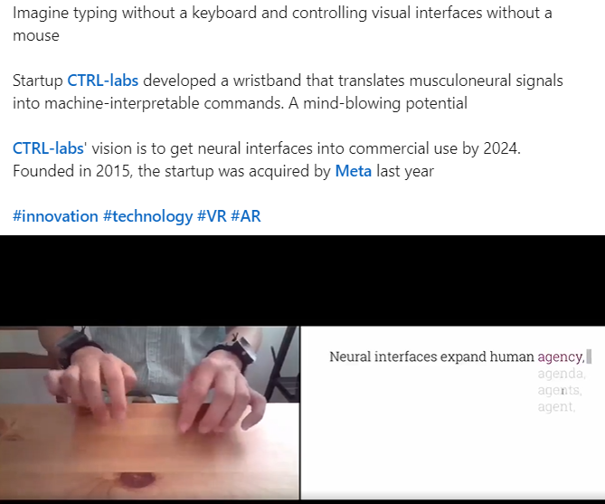
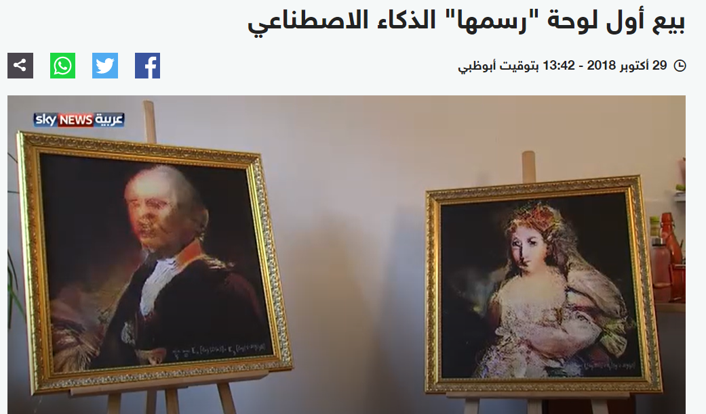
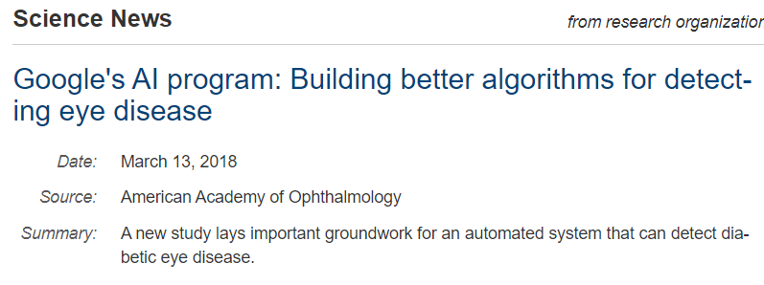
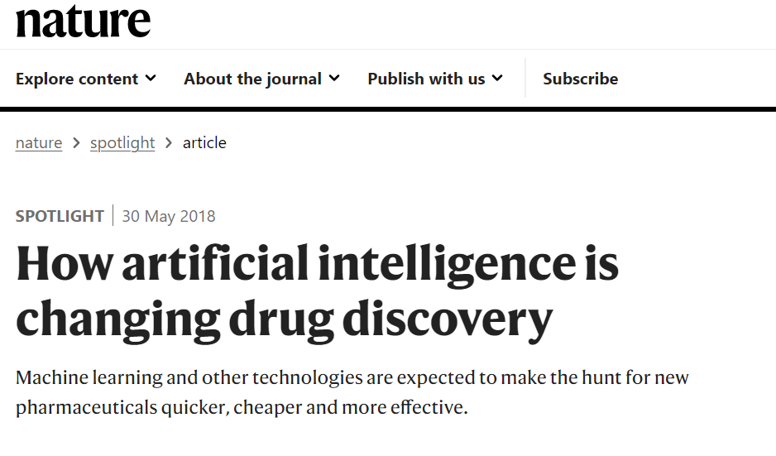

The Rise of Deep Learning

Slide 4
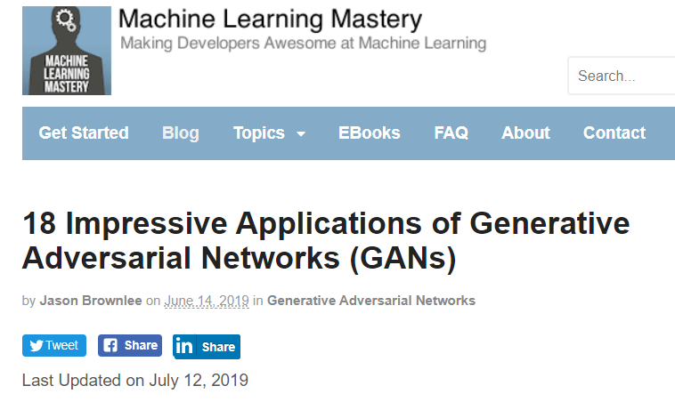
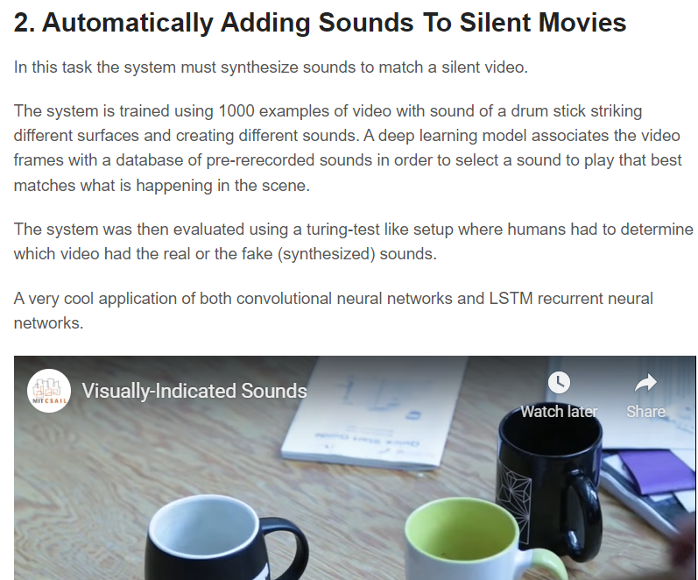
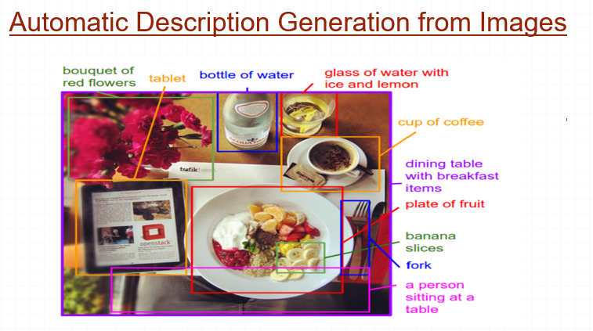
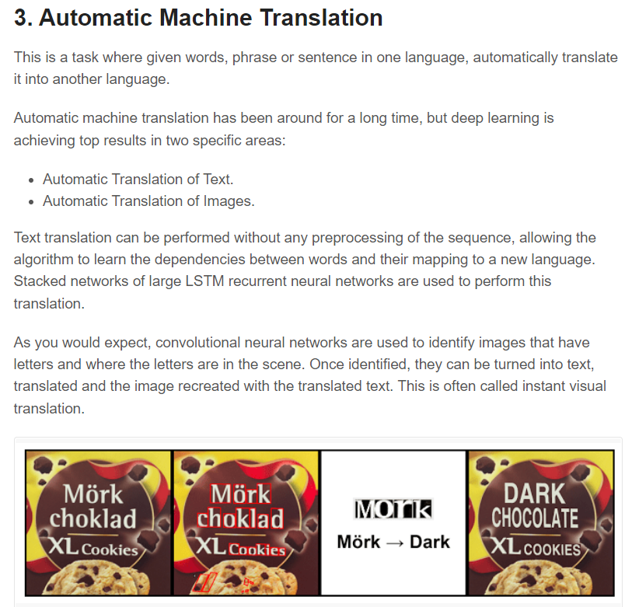
The Rise of Deep Learning

Slide 5
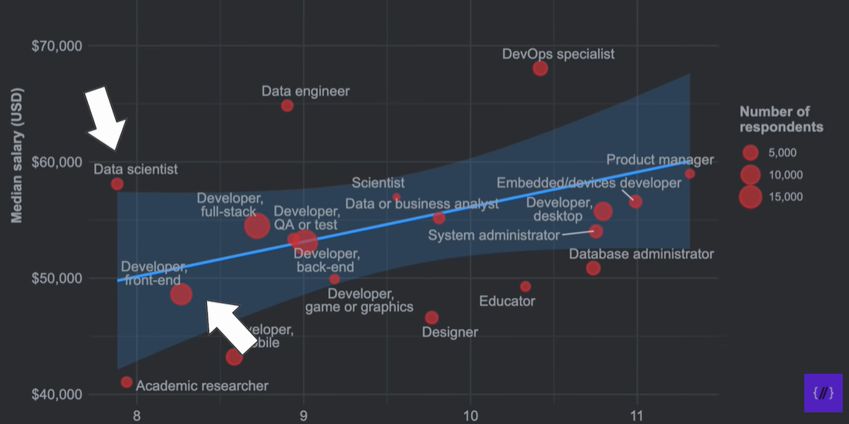
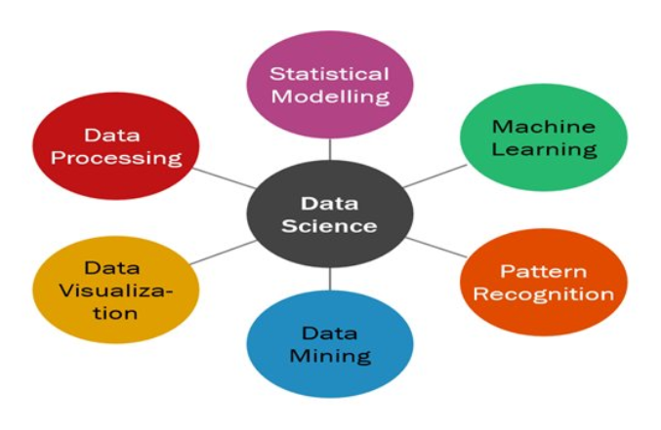

Slide 6
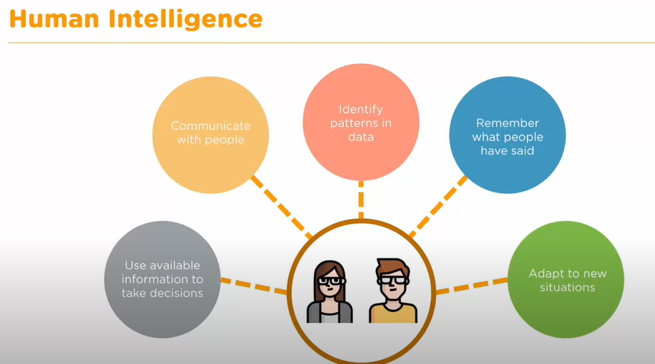

HI vs AI

Slide 7
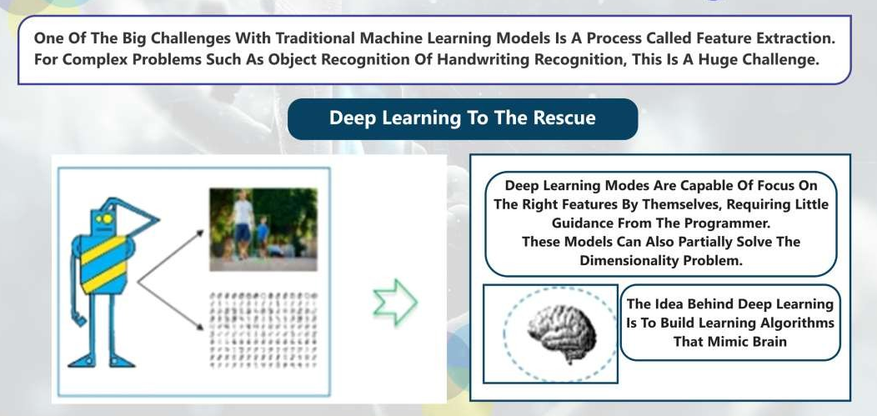
Limitation of ML

Slide 8
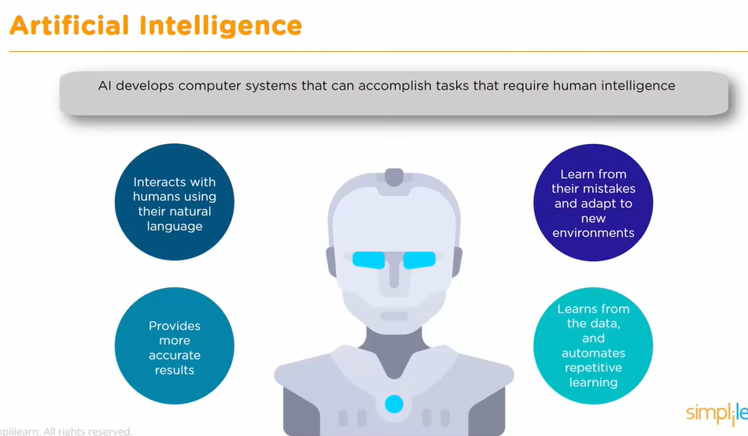

Slide 9
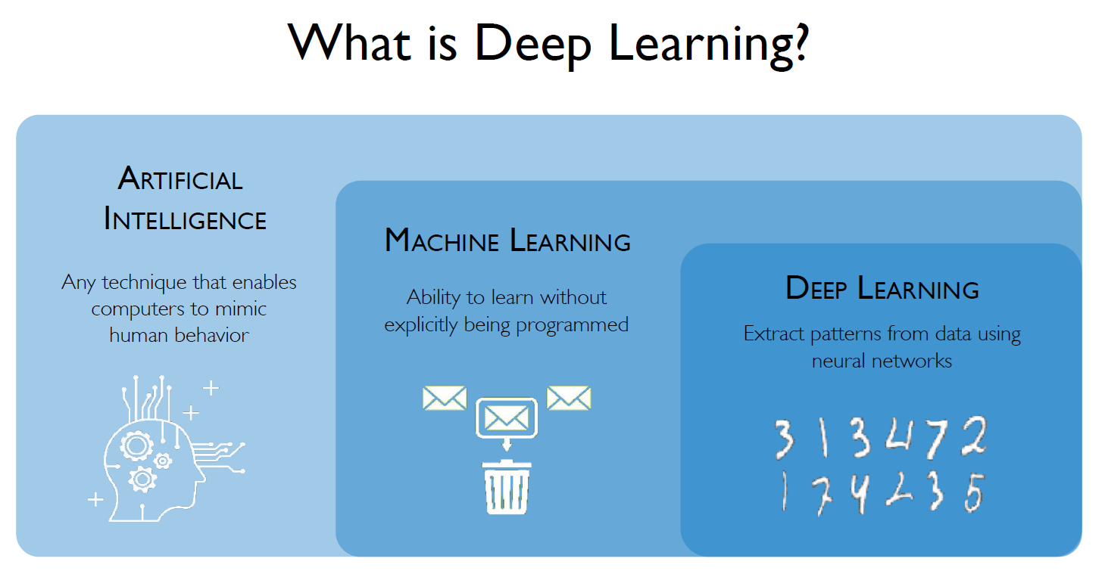

Slide 10
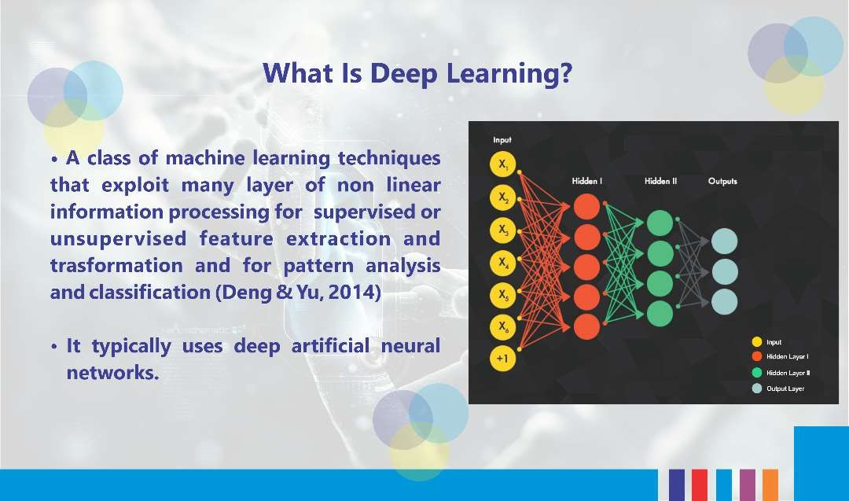
What is Deep Learning(DL)
Adapted from: www.edureka.co

Slide 11
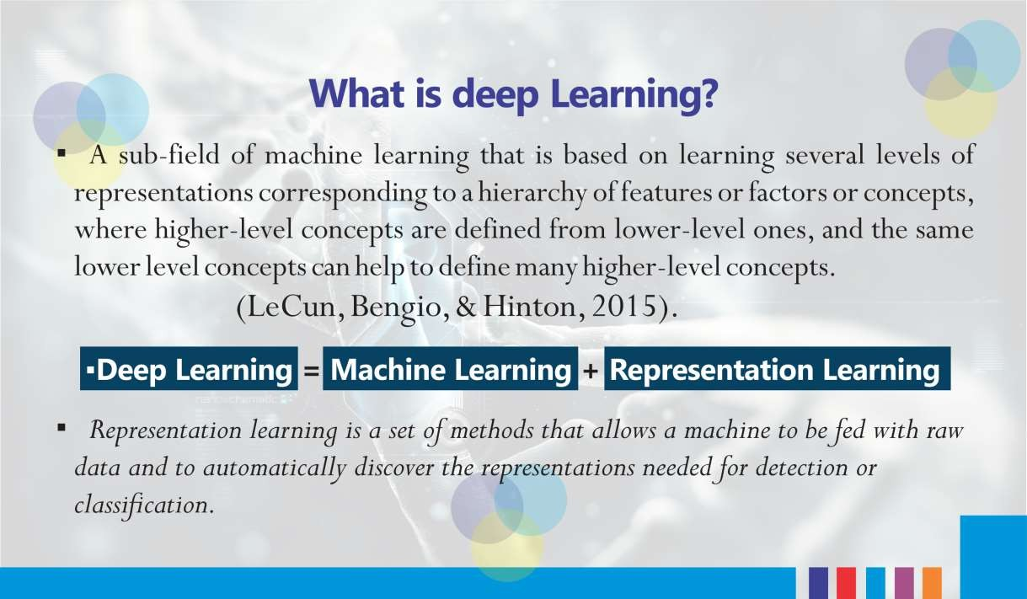
What is Deep Learning(DL)
Adapted from: www.edureka.co

Slide 12
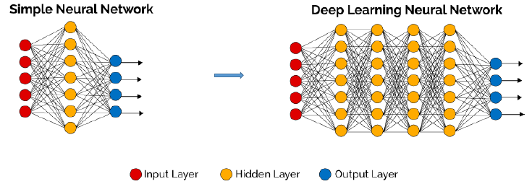
What is Deep Learning(DL)
Part or a powerful class of the machine learning field of learning representations of data. Exceptional effective at learning patterns.
Utilize learning algorithms that derive meaning out of data by using hierarchy of multiple layers that mimic the neural networks of our brain.
If you provide the system tons of information , it begins to understand it and respond in useful ways.
Stacked “Neural Network”. Is usually indicates “Deep Neural Network”.

Slide 13
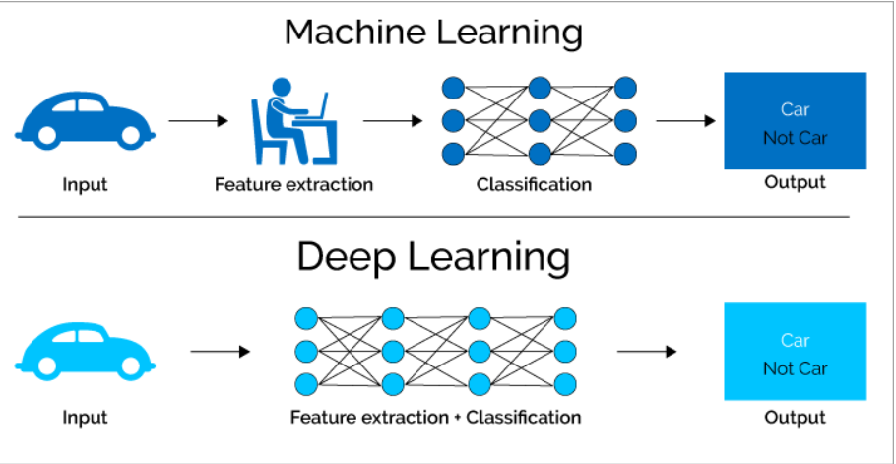
What is Deep Learning(DL)
Collection of simple, trainable mathematical functions.
Learning methods which have deep architecture.
It often allows end-to-end learning.
It automatically finds intermediate representation. Thus, it can be regarded as a representation learning.

Slide 14
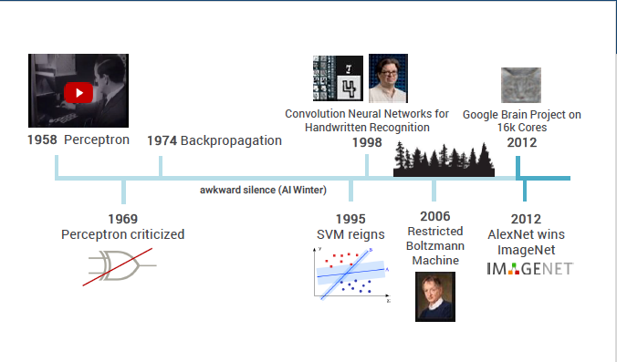
Brief History
2012 was the first year that neural nets grew to prominence as Alex Krizhevsky used them to win that year’s ImageNet competition (basically, the annual Olympics of computer vision), dropping the classification error record from 26% to 15%, an astounding improvement at the time.

Slide 15
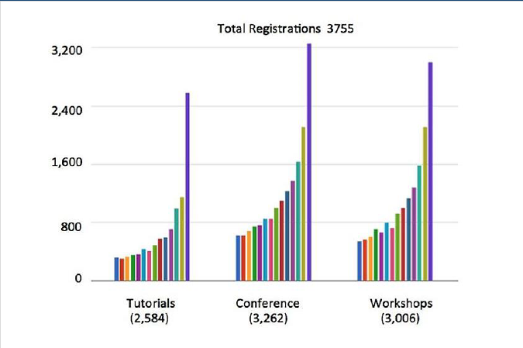
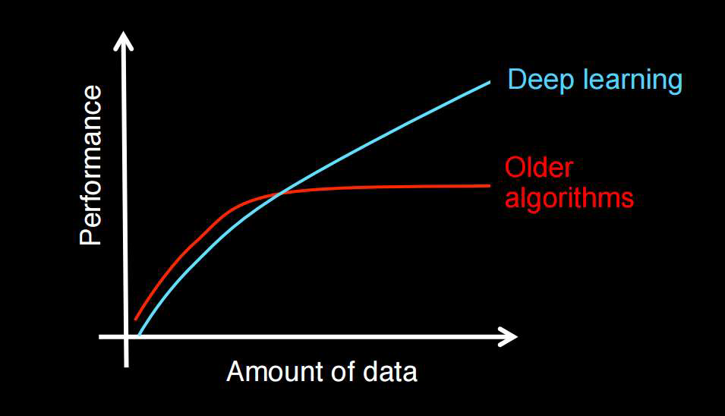
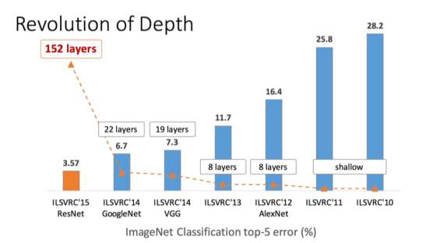
Motivations
NIPS(Computational Neuroscience Conference) Growth
Amount of Data vs Performance

Slide 16
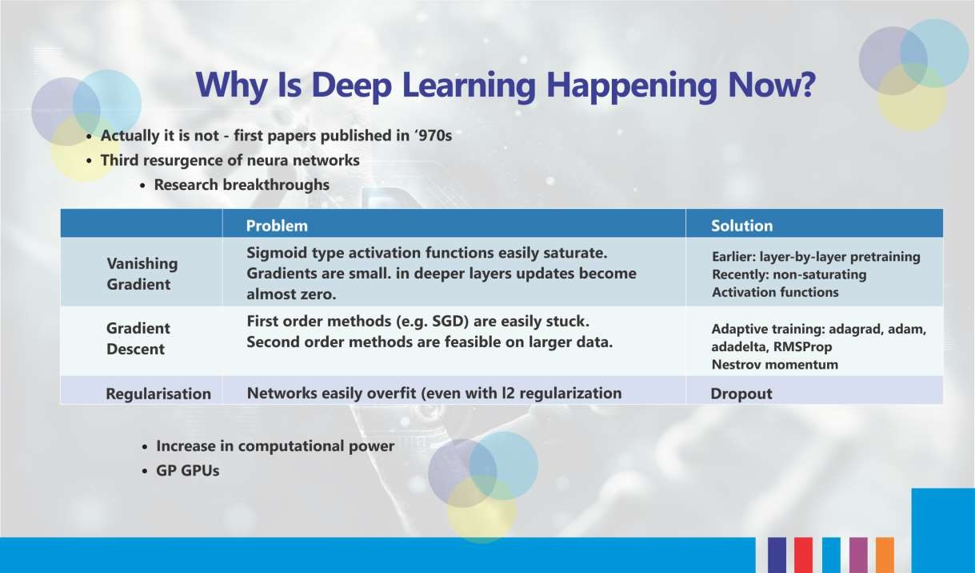
Why is Deep Learning(DL) Happening now
l
Adapted from: www.edureka.co

Slide 17
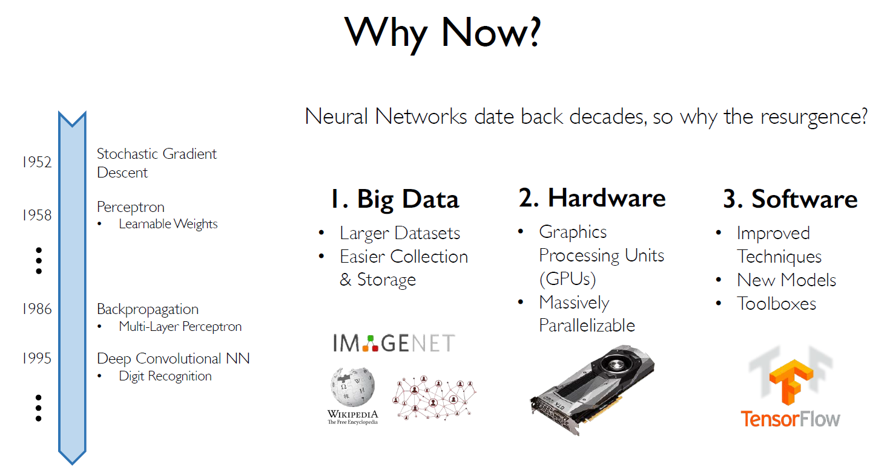
l

Slide 18
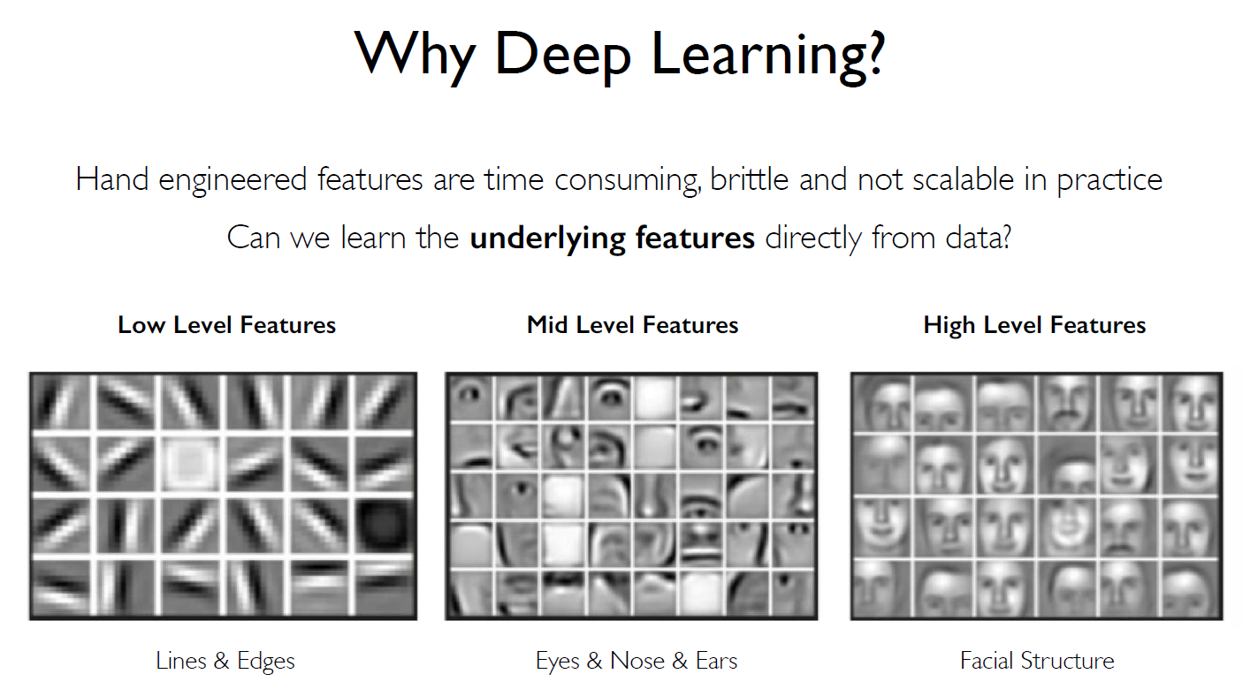
l
Adapted from: www.edureka.co

Slide 19
Types of ML Algorithms
Machine Learning
 | Supervised Learning
 | Unsupervised Learning
 | Reinforcement Learning
Supervised Learning
trained with labeled data; including regression and classification problems
Unsupervised Learning
trained with unlabeled data; clustering and association rule learning problems.
Reinforcement Learning
no training data; stochastic Markov decision process; robotics and self-driving cars.

Slide 20
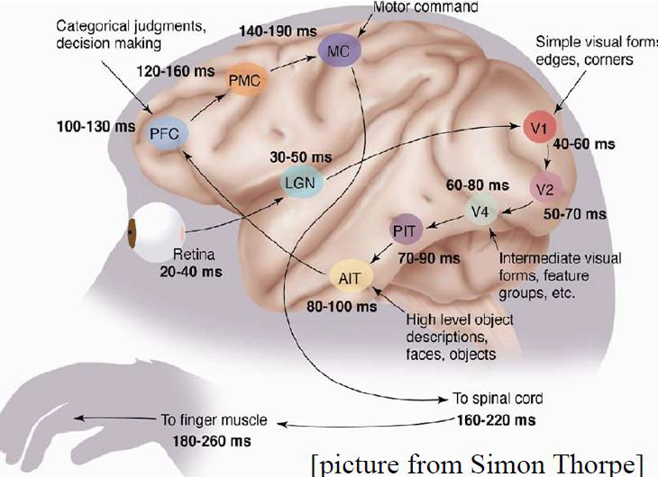
Deep Learning Basics :Neuron
Commonalities with real brains:
● Each neuron is connected to a small subset of other neurons.
● Based on what it sees, it decides what it wants to say.
● Neurons learn to cooperate to accomplish the task.
• The vental pathway in the visual cortex has multiple stages
• There exist a lot of intermediate representations

Slide 21
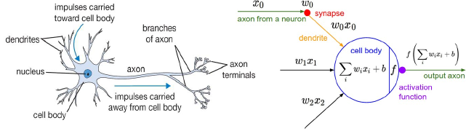
Deep Learning Basics :Neuron
An artificial neuron contains a nonlinear activation function and has several incoming and outgoing weighted connections.
Neurons are trained filters and detect specific features or patterns (e.g. edge, nose) by receiving weighted input, transforming it with the activation function and passing it to the outgoing connections

Slide 22
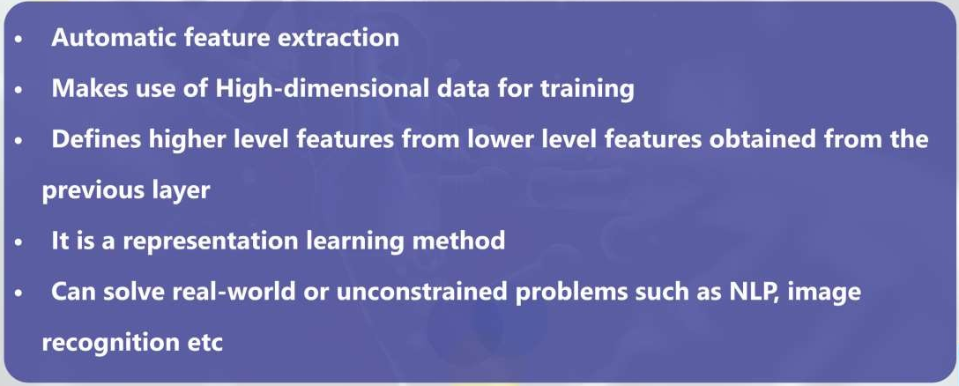
Unique Characteristics of DL
Adapted from: www.edureka.co

Slide 23
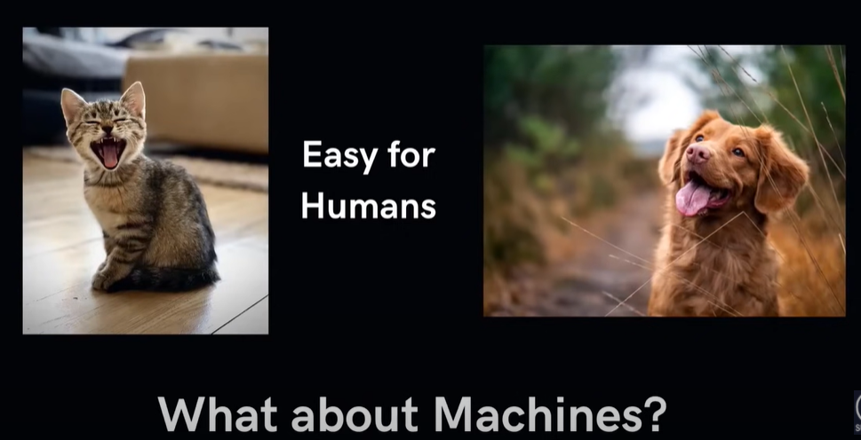

Slide 24
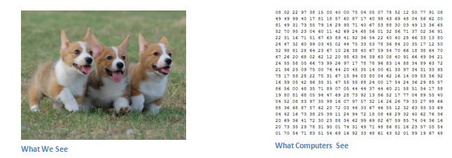
The Problem Space : inputs & outputs
Depending on the resolution and size of the image, it will see a 32 x 32 x 3 array of numbers
These numbers, while meaningless to us when we perform image classification, are the only inputs available to the computer.
The idea is that you give the computer this array of numbers and it will output numbers that describe the probability of the image being a certain class (.80 for cat, .15 for dog, .05 for bird, etc).

Slide 25
The Problem Space :What We Want the Computer to Do
To be able to differentiate between all the images it’s given and figure out the unique features that make a dog a dog or that make a cat a cat.
This is the process that goes on in our minds subconsciously as well.
When we look at a picture of a dog, we can classify it as such if the picture has identifiable features such as paws or 4 legs.
In a similar way, the computer is able perform image classification by looking for low level features such as edges and curves, and then building up to more abstract concepts through a series of convolutional layers.

Slide 26
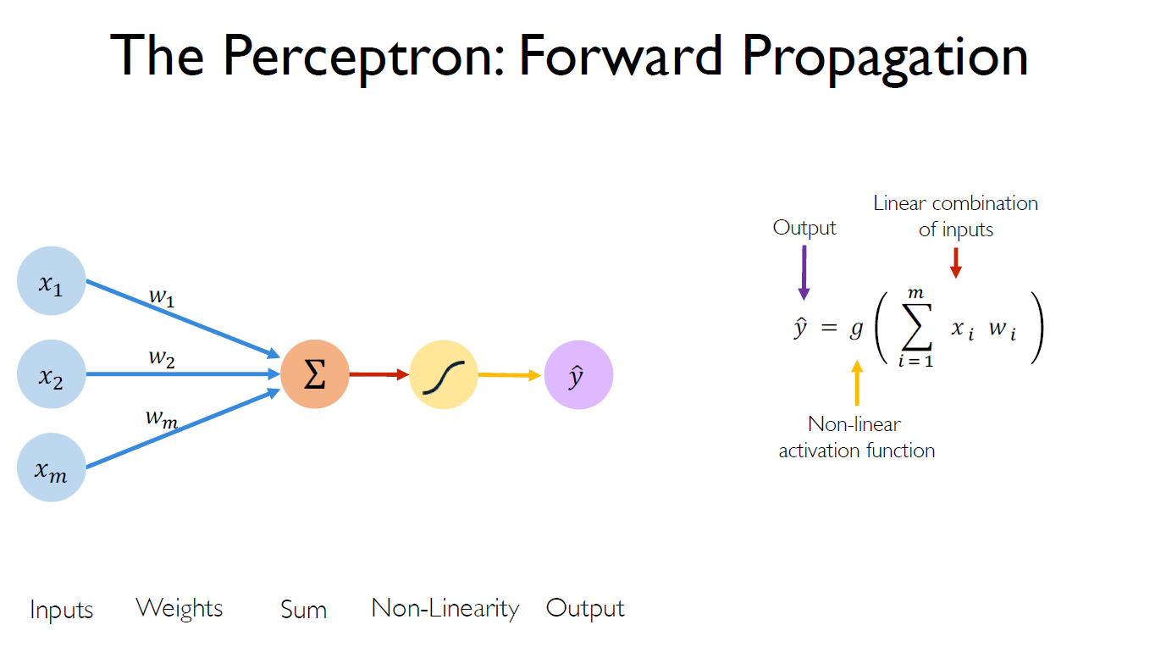

Slide 27
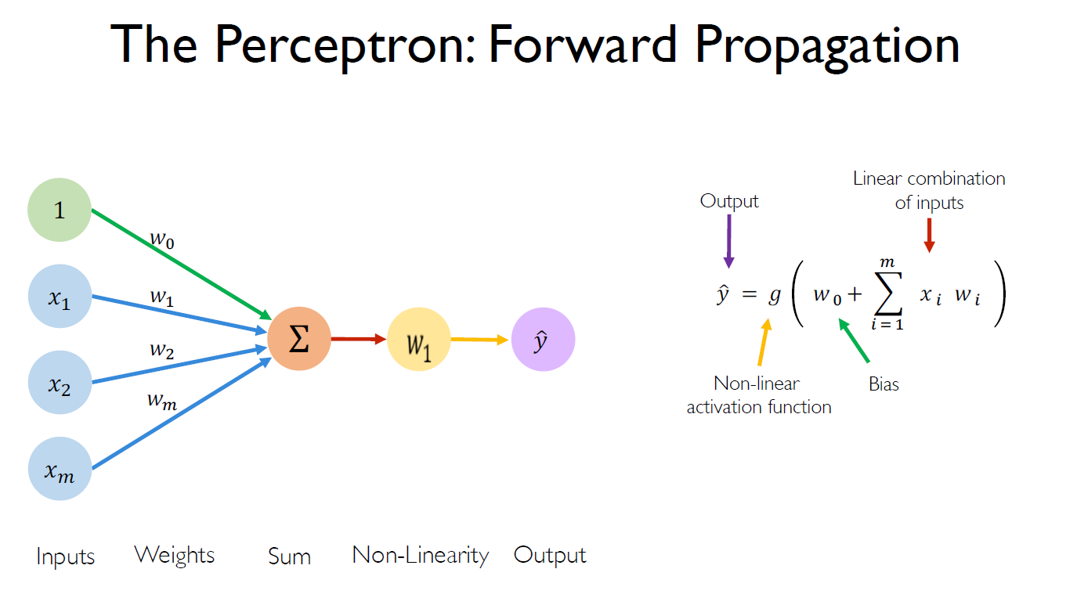

Slide 28
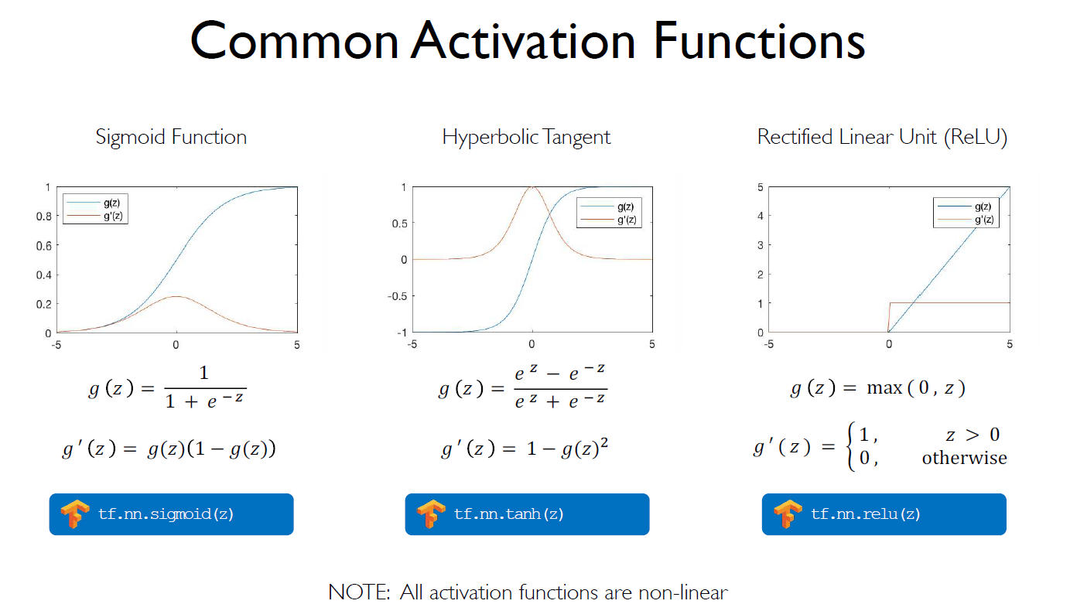

Slide 29
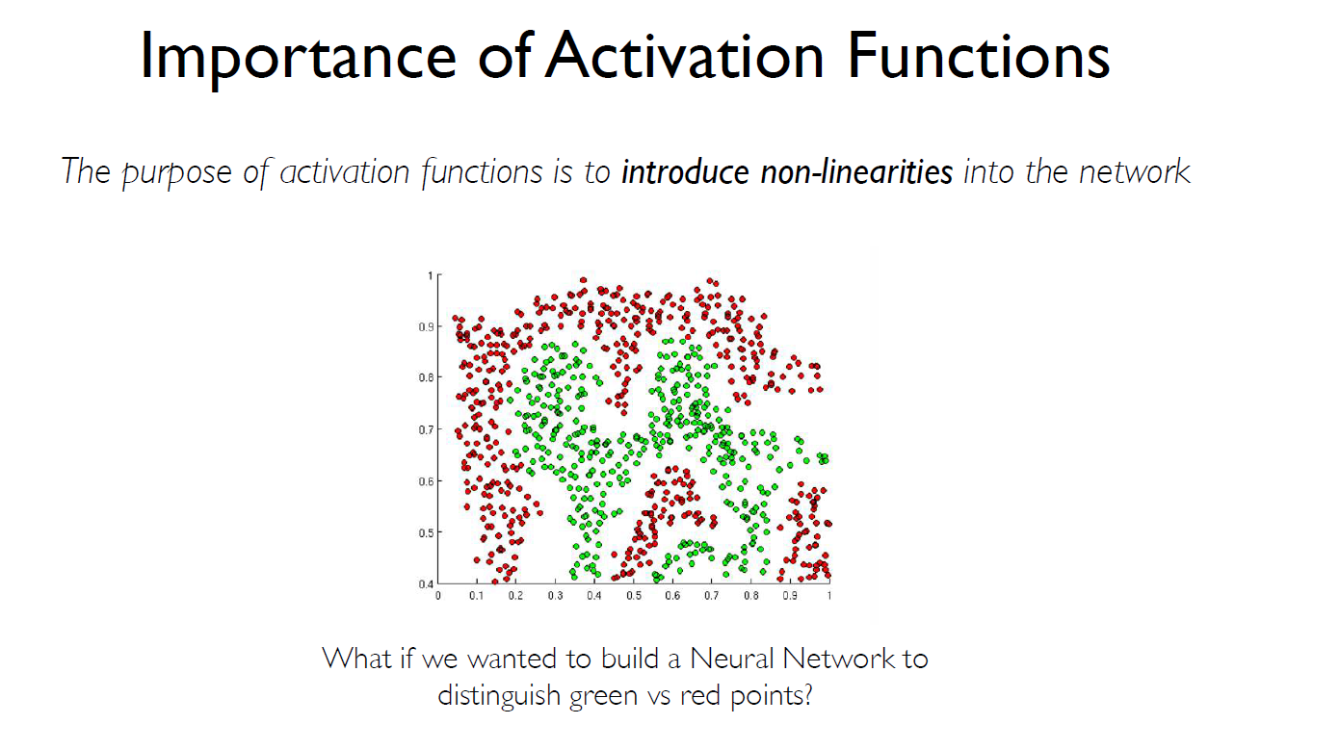

Slide 30
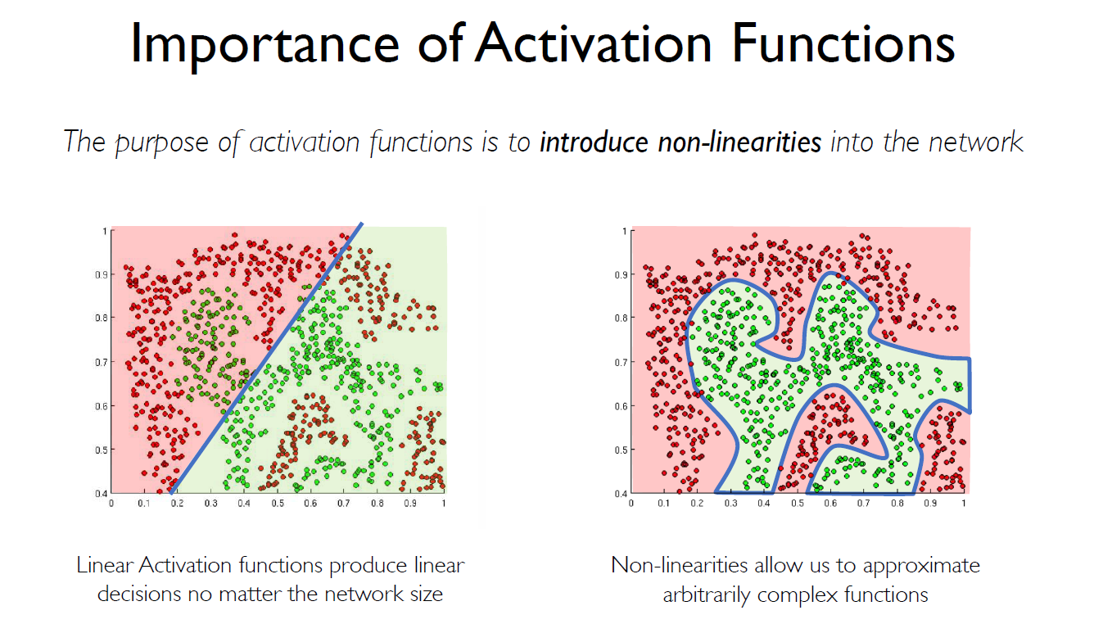

Slide 31
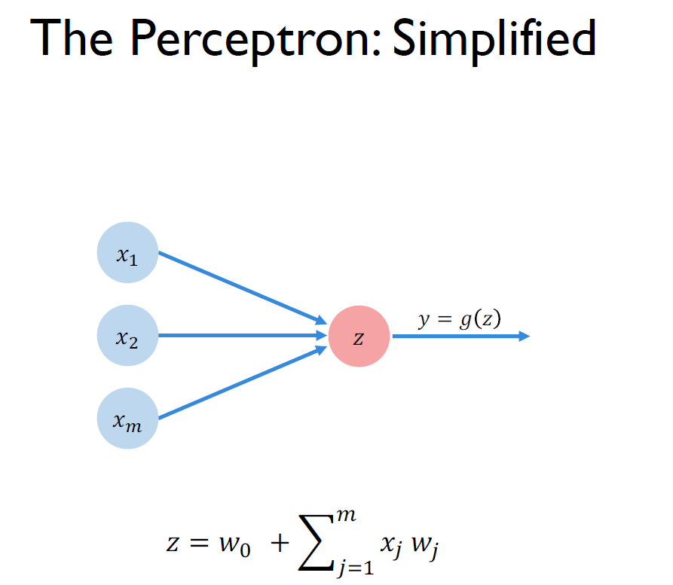

Slide 32
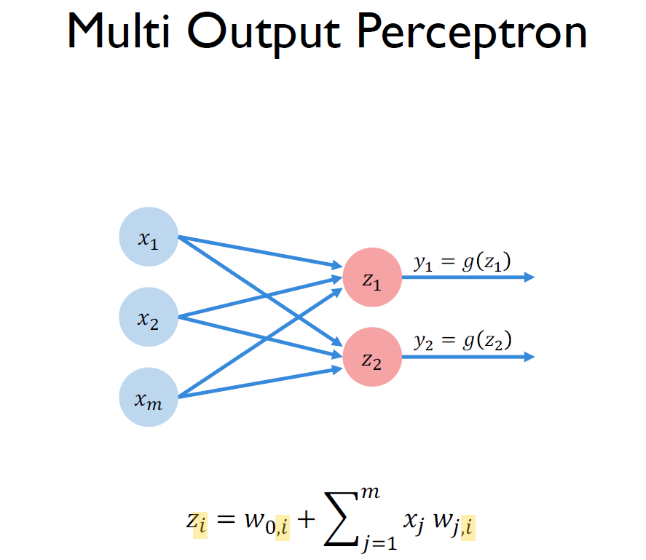

Slide 33
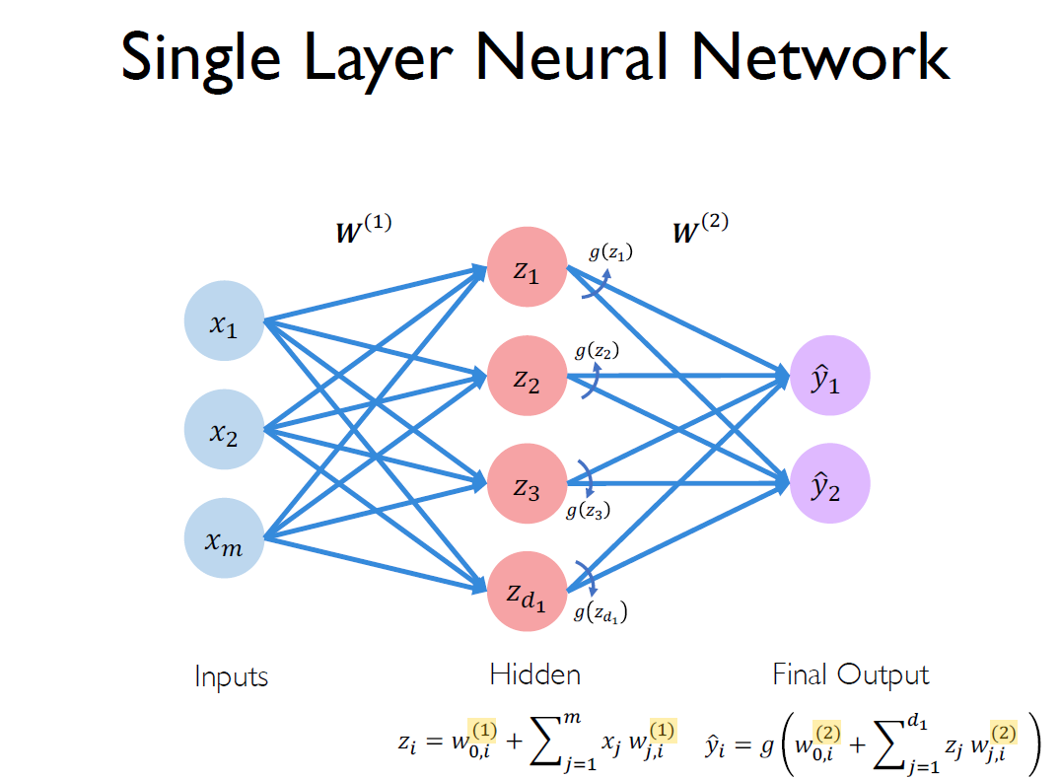

Slide 34
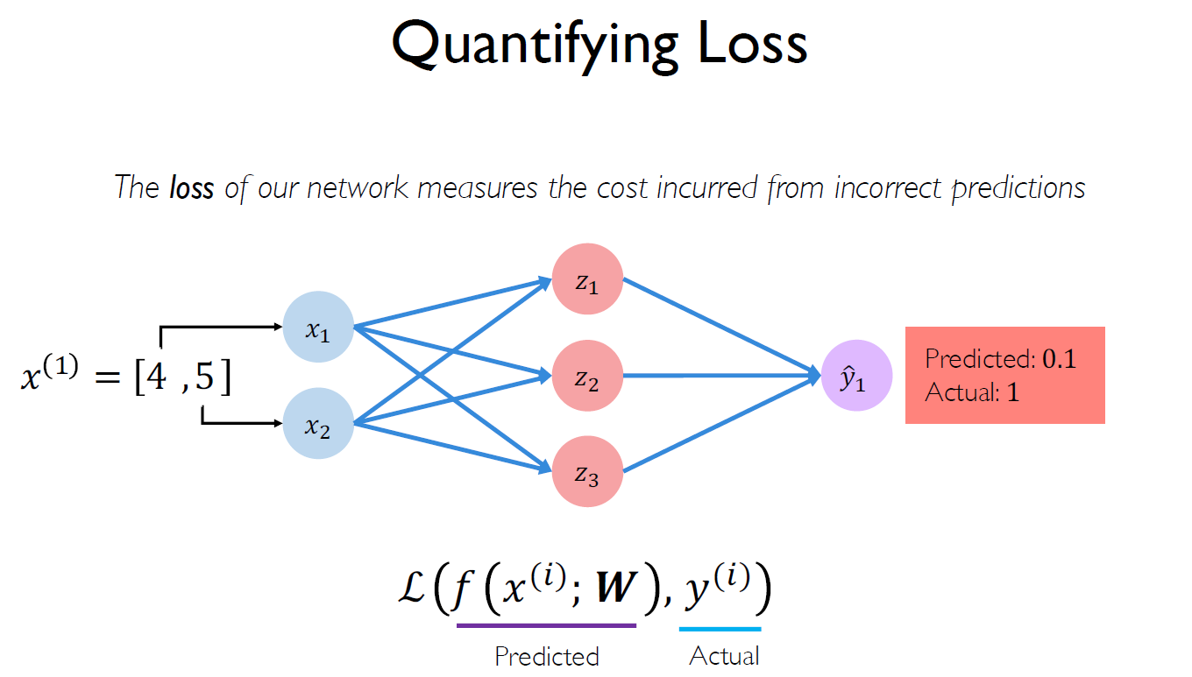

Slide 35
Types of Networks used for Deep Learning
Convolutional Neural Networks(Convnet,CNN)
Recurrent Neural Networks(RNN)
Long Short Term Memory (LSTM) networks
Deep/Restricted Boltzmann Machines (RBM)
Deep Q-networks
Deep Belief Networks(DBN)
Deep Stacking Networks

Slide 36
Convolution Neural Networks(CNN):Basic Idea
This idea was expanded upon by a fascinating experiment by Hubel and Wiesel in 1962 where they showed that some individual neuronal cells in the brain responded (or fired) only in the presence of edges of a certain orientation.
For example, some neurons fired when exposed to vertical edges and some when shown horizontal or diagonal edges. Hubel and Wiesel found out that all of these neurons were organized in a columnar architecture and that together, they were able to produce visual perception.
This idea of specialized components inside of a system having specific tasks (the neuronal cells in the visual cortex looking for specific characteristics) is one that machines use as well, and is the basis behind CNNs.

Slide 37
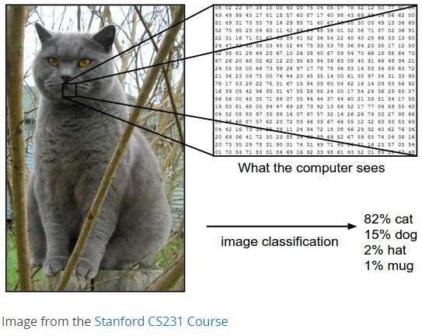
Inputs and Outputs
256 X 256
Matrix
DL model
4-Element Vector
X
Y
1
2
3
4
5
6
A C T G
M F
With deep learning, we are searching for a surjective
(or onto) function f from a set X to a set Y.

Slide 38
Learning Principle
Dataset
Output/Prediction
Target Output
x x
1 2
…..
x
n
Error:
-
= 5
(Image Credit: NVIDIA Deep Learning Institute)

Slide 39
Learning Principle
Output/Prediction
Target Output
x x
1 2
…..
x
n
Error:
-
= 15
(Image Credit: NVIDIA Deep Learning Institute)

Slide 40
Learning Principle
Output/Prediction
Target Output
x x
1 2
…..
x
n
Error:
-
= 2.5

Slide 41

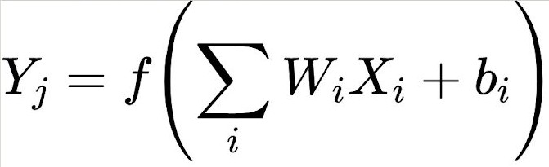



Supervised Deep Learning with Neural Networks
Input Hidden Layers
Output
From one layer to the next
X₁
W₁
f is the activation function, W_{i} is the weight, and b_{i} is the bias.
X₂
W₂
Y₃
X₃
W₃

Slide 42

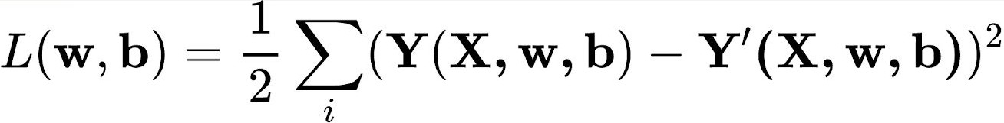


Training - Minimizing the Loss
The loss function with regard to weights and biases can be defined as
Input
Output
W₁, b₁
X₁
Y₂
The weight update is computed by moving a step to the opposite direction of the cost gradient.
W₂, b₂
X
2
L
W₃, b₃
X₃
Iterate until L stops decreasing.

Slide 43

Convolution in 2D
(Image Credit: Applied Deep Learning | Arden Dertat)

Slide 44


Convolution Kernel
(Image Credit: Applied Deep Learning | Arden Dertat)

Slide 45


Convolution on Image
Image Credit: Deep Learning Methods for Vision | CVPR 2012 Tutorial

Slide 46

Activation

Slide 47


Introducing Non-Linearity (ReLU)
Image Credit: Deep Learning Methods for Vision | CVPR 2012 Tutorial

Slide 48


Max Pooling
(Image Credit: Applied Deep Learning | Arden Dertat)

Slide 49


Pooling - Max-Pooling and Sum-Pooling
Image Credit: Deep Learning Methods for Vision | CVPR 2012 Tutorial

Slide 50

Convolutional Neural Networks
A convolutional neural network (CNN, or ConvNet) is a class of deep, feed-forward artificial neural networks that explicitly assumes that the inputs are images, which allows us to encode certain properties into the architecture.
LeNet-5 Architecture (Image Credit: https://becominghuman.ai)

Slide 51
CNN Layers
1
Convolution Layer
2
Batch Normalization Layer
3
RELU Layer
4
Local Response Normalization Layer
5
Max and AVG Pooling
6
Dropout Layer
7
Fully Connected Layer (FC)
8
Output Layer (SOFT MAX ,Regression )

Slide 52

Convolution Neural Networks(CNN)
DEFENITION
Convolutional neural networks learn a complex representation of visual data using vast amounts of data .they are inspired by human visual system and learn multiple layers of transformations , which are applied on top of each other to extract progressively more sophisticated representation of the input .
Notes
CNN have multiple types of layers ,the first of which is the Convolutional layer.
Inspired by the visual cortex and Pioneered by Yann Lecun (NYU).

Slide 53

Generative Adversarial Network

Slide 54

Diffusion model

Slide 55

MLP Mixture Model

Slide 56

Transformer

Slide 57

Graph Neural Network

Slide 58
Google Colab
https://colab.research.google.com/drive/17y5TXNHsz3Ij8Y5sbX32q3vbOxYF3L1n?usp=sharing

Slide 59

Thank You
Reference:
Introduced by : Dr. Amr Rashed Lecturer, Department of Computer Engineering, College of Computers and Information Technology, Taif University
Zhenhua He

